Slide 2
Reinforcement Learning
Lecture 5 – Multi-Armed Bandits
Author: Jose Cassio dos Santos Jr.

Slide 3
Course Agenda
Lecture 1
Introduction to Reinforcement Learning
Finite Markov Decision Process
Bellman Equations
Dynamic Programming
Lecture 2
Monte Carlo Methods
Temporal-Difference Learning
SARSA and Q-Learning
Lecture 3
On Policy Prediction and Control with Approximation
Off Policy Methods with Approximation
Lecture 4
Policy Gradient Methods
Lecture 5
Multi-armed Bandits

Slide 4
Today’s Outline
K-armed bandit problem
Exploration vs. Exploitation
Action-value Method
The 10 Armed Testbed
Incremental implementation
Tracking a Non-Stationary problem
Optimistic initial values
Upper-Confidence-Bound Action Selection
Gradient Bandits
Contextual Bandits
NEXT TOPIC: Multi-Armed Bandits

Slide 5
Multi-Armed Bandits

Slide 6
The Multi-Armed Bandit Problem
The multi-armed bandit problem
Suppose you are faced with N slot machines (called multi-armed bandits)
Each bandit has an unknown probability of distributing a prize (assume for now the prizes are the same)
Some bandits have very generous probabilities, but you don’t know what these are
Our task is to maximize our winnings
Objective
Maximize the expected total reward over some time period, for example, over 1000 action selections, or time steps.
Notes:
One-armed bandit: a slot machine operated by pulling a long handle at the side.

Slide 7

The Multi-Armed Bandit Problem
Typical Tasks of an RL problem
The simplest reinforcement learning problem.
Different actions yield different rewards.
Rewards are delayed over time. Even getting the immediate reward, we may not know it till later in time.
Reward for an action is conditional on the state of the environment.
The k-armed bandit is a nice starting place because we don’t have to worry about aspects 2 and 3.

Slide 8
The Multi-Armed Bandit Problem
The multi-armed bandit problem
We need to focus in learning which rewards we get for each of the possible actions, and ensuring we chose the optimal ones.
In other words, we are learning a policy.
We are going to be using policy gradients, where our simple neural network learns a policy for picking actions by adjusting it’s weights through gradient descent using feedback from the environment.

Slide 9
The Multi-Armed Bandit Problem
Applying Policy Gradient for a Bandit Problem
We’ve seen that a Policy gradient network is one which produces explicit outputs.
In the case of our bandit, we don’t need to condition these outputs on any state.
Our network will consist of just a set of weights, each corresponding to each of the possible arms to pull in the bandit, and will represent how good our agent thinks it is to pull each arm.

Slide 10

The Multi-Armed Bandit Problem
Applying Policy Gradient for a Bandit Problem
To updating the network
We will try an arm with an 𝜀-greedy policy.
In the case of our bandit, we don’t need to condition these outputs on any state.
Once our agent has taken an action, it then receives a reward of either 1 or -1.
Let’s do some coding! K-Armed Bandit Problem

Slide 11
Applications
Internet display advertising
Companies have a suite of potential ads they can display to visitors, but the company is not sure which ad strategy to follow to maximize sales.
Sports
An Athlete has a finite amount of energy to expend, and following certain behaviors has uncertain rewards. How does the athlete maximize their fitness?
Finance
Which stock option gives the highest return, under time-varying return profiles.
Clinical Trials
A researcher would like to find the best treatment, out of many possible treatments, while minimizing losses.
NEXT TOPIC: Exploration vs Exploitation

Slide 12
Exploration vs Exploitation

Slide 13
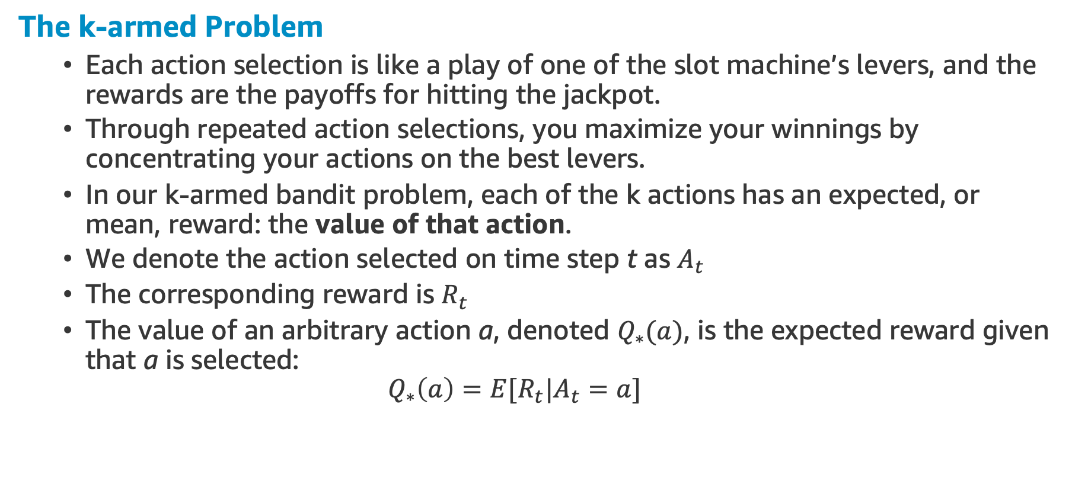
The k-armed Bandit Problem
The k-armed Problem
Each action selection is like a play of one of the slot machine’s levers, and the rewards are the payoffs for hitting the jackpot.
Through repeated action selections, you maximize your winnings by concentrating your actions on the best levers.
In our k-armed bandit problem, each of the k actions has an expected, or mean, reward: the value of that action.
We denote the action selected on time step t as $A_{t}$
The corresponding reward is $R_{t}$
The value of an arbitrary action a, denoted $Q_{∗}(a)$, is the expected reward given that a is selected:
$$Q_{∗}\left(a\right)=E[R_{t}|A_{t}=a]$$

Slide 14
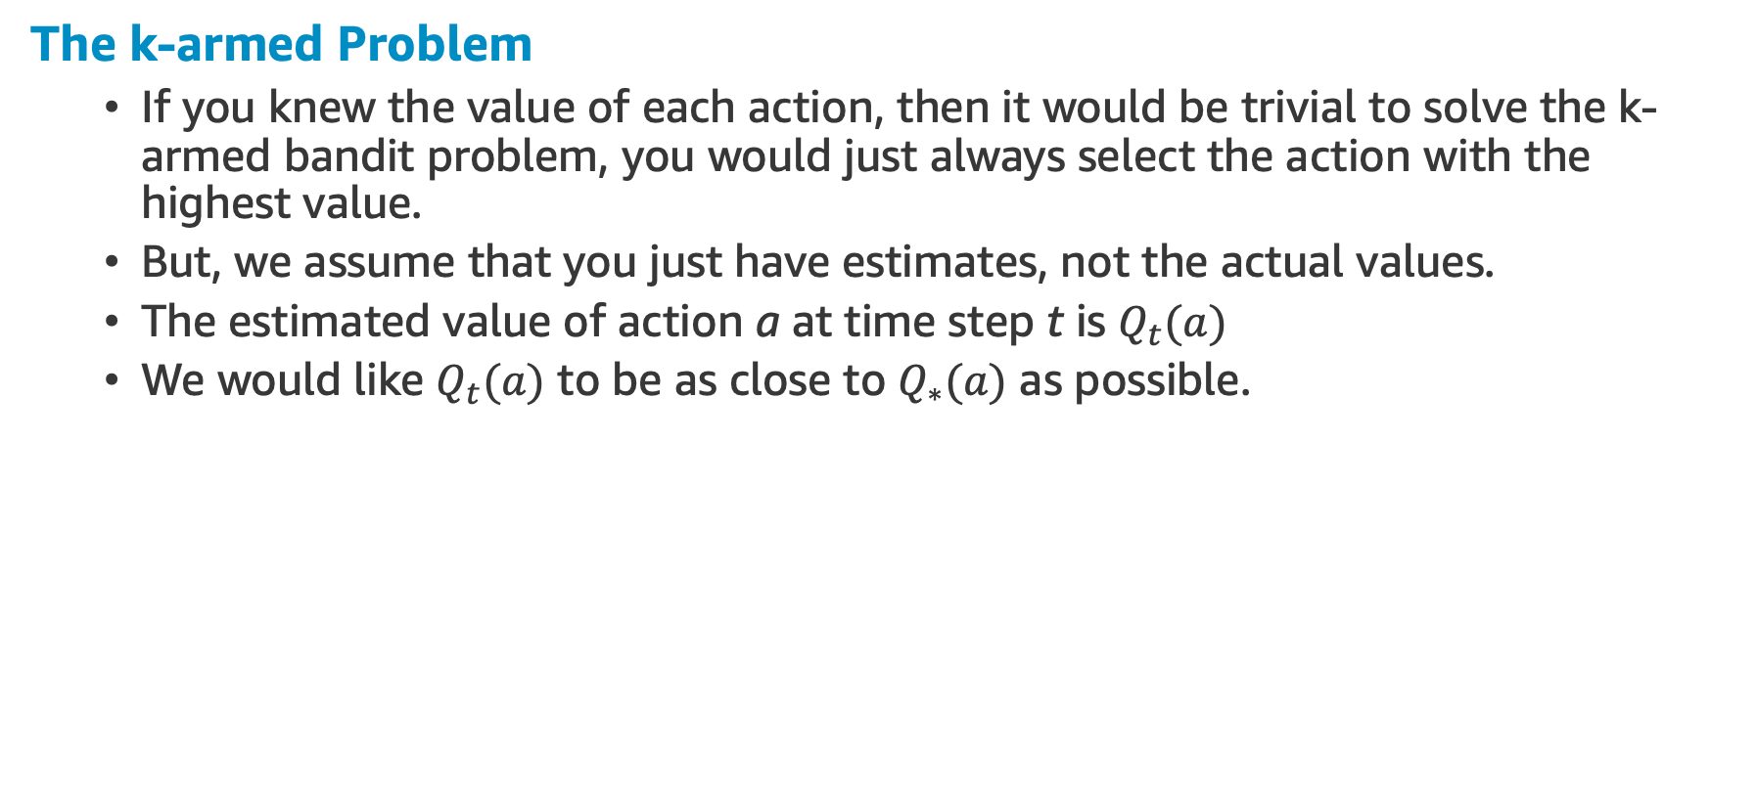
The k-armed Bandit Problem
The k-armed Problem
If you knew the value of each action, then it would be trivial to solve the k-armed bandit problem, you would just always select the action with the highest value.
But, we assume that you just have estimates, not the actual values.
The estimated value of action a at time step t is $Q_{t}(a)$
We would like $Q_{t}(a)$ to be as close to $Q_{∗}(a)$ as possible.

Slide 15
Exploration vs Exploitation
Greedy Actions
At any time step, there is at least one action whose estimated value is greatest.
When you select one of these actions, we say that you are exploiting your current knowledge of the actions and values.
Non-Greedy Actions
If instead, you select one of the non-greedy actions, then we say that you are exploring, because this enables you to improve your estimate of the non-greedy action’s value.

Slide 16
Exploration vs Exploitation
Jeff Bezos has an interesting way to frame this decision with his “regret minimization” framework:
“So, I wanted to project myself forward to the age 80 and say, ‘Okay, now I’m looking back on my life. I want to have minimized the number of regrets I have.’ I knew that when I was 80 I was not going to regret having tried this. I was not going to regret trying to participate in this thing called the Internet that I thought was going to be a really big deal. I knew that if I failed, I wouldn’t regret that.”
(Algorithms to live by)

Slide 17
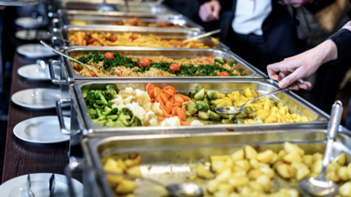
Exploration vs Exploitation
The world is constantly full of “explore vs exploit” tradeoffs – whether you should take known gains or take the exploration cost to see if better options are available.
Fun Fact
Boredom and mental fatigue are very possibly evolutionary-evolved prompts to switch from exploit mode to explore mode.

Slide 18

Exploration vs Exploitation
Why use exploration in RL?
Suppose a greedy action’s value is known with certainty, while several other actions are estimated to be nearly as good but with substantial uncertainty.
The uncertainty is such that at least one of these other actions probably is actually better than the greedy action, but you don’t know which one.

Slide 19
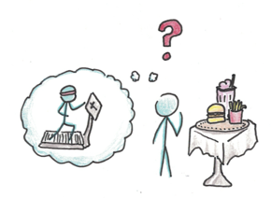
Exploration vs Exploitation
Why use exploration in RL?
If you have many time step opportunities to make action selections, then it may be better to explore the non-greedy actions and discover which of them are better than the greedy action.
The reward is lower in the short run, during exploration, but higher in the long run because after you have discovered the better actions, you can exploit them many times.

Slide 20
Exploration vs Exploitation
And about balancing them?
In any specific case, whether it is best to explore or exploit depends in a complex way on the precise values of the estimates, uncertainties, and the number of remaining steps.
Here we won’t worry about balancing exploration and exploitation in a sophisticated way.
We worry only about balancing them at all.
We will present several simple balancing methods for the k-armed bandit problem and show that they work much better than methods that always exploit.
The simplicity of our version of the k-armed bandit problem enables us to show this in a particularly clear form.
NEXT TOPIC: Action-Value Methods

Slide 21
Action-Value Methods

Slide 22
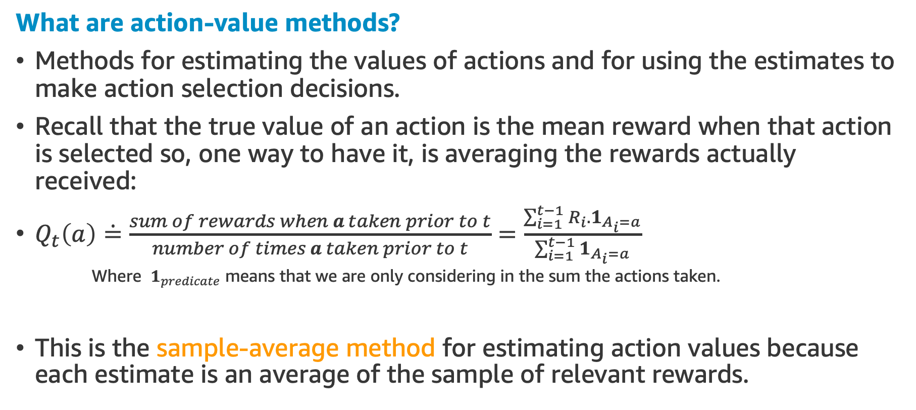
Action-value Methods
What are action-value methods?
Methods for estimating the values of actions and for using the estimates to make action selection decisions.
Recall that the true value of an action is the mean reward when that action is selected so, one way to have it, is averaging the rewards actually received:
$Q_{t}\left(a\right)\dot{=}\frac{sum of rewards when a taken prior to t}{number of times a taken prior to t}=\frac{\sum_{i=1}^{t−1}{R_{i}.1_{A_{i}=a}}}{\sum_{i=1}^{t−1}{1_{A_{i}=a}}}$
Where $1_{predicate}$ means that we are only considering in the sum the actions taken.
This is the sample-average method for estimating action values because each estimate is an average of the sample of relevant rewards.
Notes:
You are summing separately for each actions taken

Slide 23
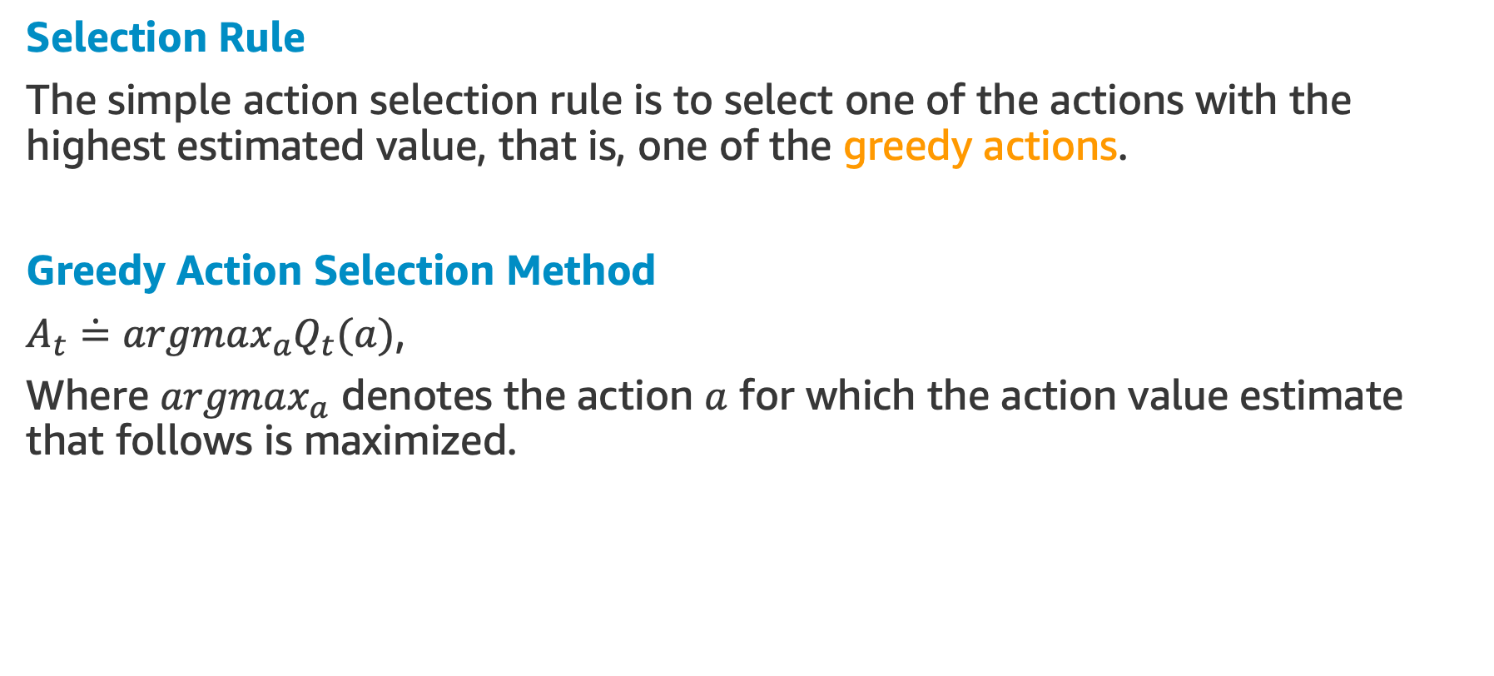
Action-value Methods
Selection Rule
The simple action selection rule is to select one of the actions with the highest estimated value, that is, one of the greedy actions.
Greedy Action Selection Method
$A_{t}\dot{=}argmax_{a}Q_{t}(a)$,
Where $argmax_{a}$ denotes the action $a$ for which the action value estimate that follows is maximized.

Slide 24
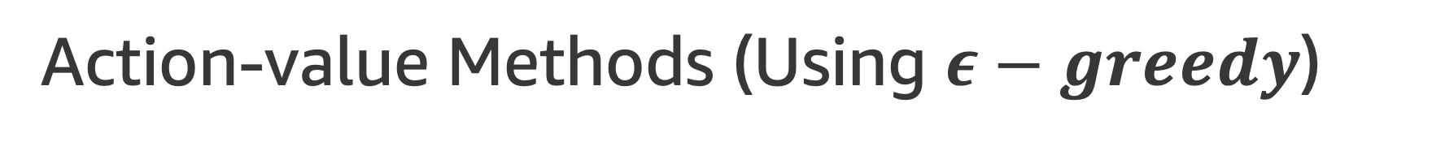
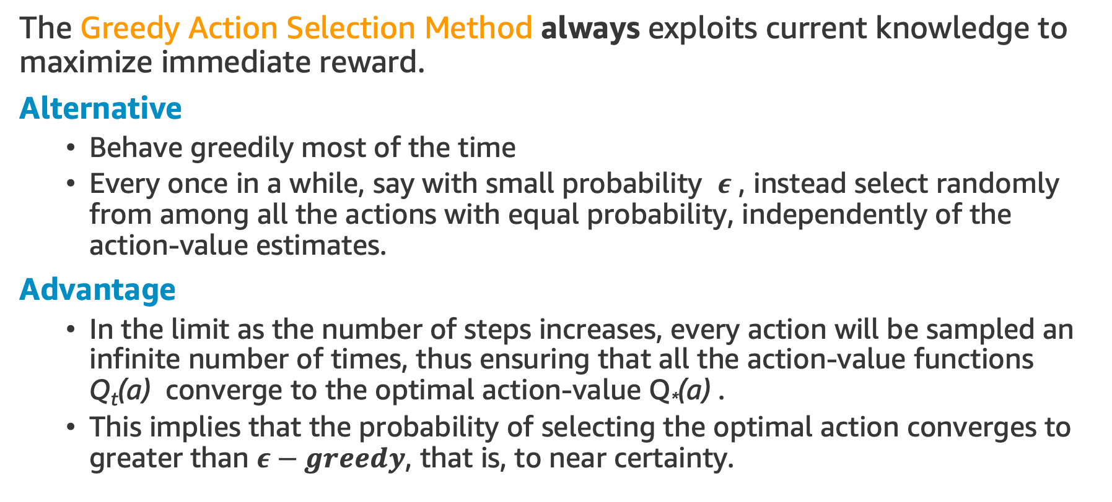
Action-value Methods (Using $ε−greedy$)
The Greedy Action Selection Method always exploits current knowledge to maximize immediate reward.
Alternative
Behave greedily most of the time
Every once in a while, say with small probability $ε$ , instead select randomly from among all the actions with equal probability, independently of the action-value estimates.
Advantage
In the limit as the number of steps increases, every action will be sampled an infinite number of times, thus ensuring that all the action-value functions Q_{t}(a) converge to the optimal action-value Q*(a) .
This implies that the probability of selecting the optimal action converges to greater than $ε−greedy$, that is, to near certainty.
Notes:
Converges to the optimal Value Function

Slide 25

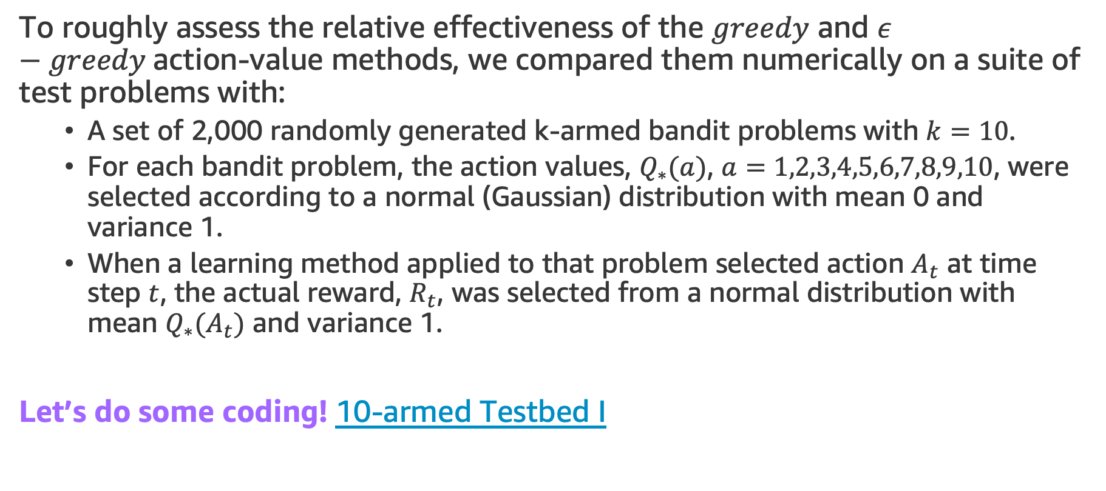
The 10-armed Testbed
To roughly assess the relative effectiveness of the $greedy$ and $ε−greedy$action-value methods, we compared them numerically on a suite of test problems with:
A set of 2,000 randomly generated k-armed bandit problems with $k=10$.
For each bandit problem, the action values, $Q_{∗}(a)$, $a=1,2,3,4,5,6,7,8,9,10$, were selected according to a normal (Gaussian) distribution with mean 0 and variance 1.
When a learning method applied to that problem selected action $A_{t}$ at time step $t$, the actual reward, $R_{t}$, was selected from a normal distribution with mean $Q_{∗}(A_{t})$ and variance 1.
Let’s do some coding! 10-armed Testbed I

Slide 26
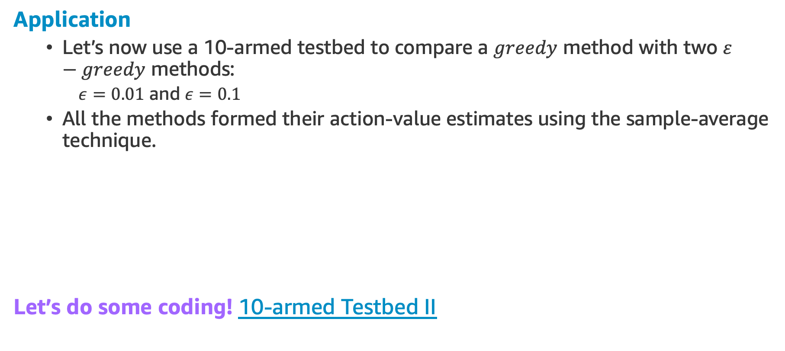
The 10-armed Testbed
Application
Let’s now use a 10-armed testbed to compare a $greedy$ method with two $ε−greedy$ methods:
$ε=0.01$ and $ε=0.1$
All the methods formed their action-value estimates using the sample-average technique.
Let’s do some coding! 10-armed Testbed II

Slide 27
Again Exploration vs Exploitation
The trade-off depends on the task
Suppose the reward variance had been larger, say 10 instead of 1.
Higher variance leads to noisier rewards
More exploration is needed to find the optimal action
On the other hand, if the reward variances were zero
The greedy method would know the true value of each action after trying it once, actually performing best because it would soon find the optimal action and then never explore.

Slide 28
Again Exploration vs Exploitation
But…
Even in the deterministic case, there is a large advantage to exploring if we weaken some of the other assumptions.
If the bandit task were non-stationary, that is, the true values of the actions changed over time, we’d need to explore those changes. Because maybe a non-greedy action has changed and is now better than the greedy.
NEXT TOPIC: Incremental Implementation

Slide 29
Incremental Implementation

Slide 30
Incremental Implementation
The action-value methods we have discussed so far all estimate values as sample averages of observed rewards.
But, how these averages can be computed in a computationally efficient manner, in particular, with constant memory and constant per-time-step computation?

Slide 31
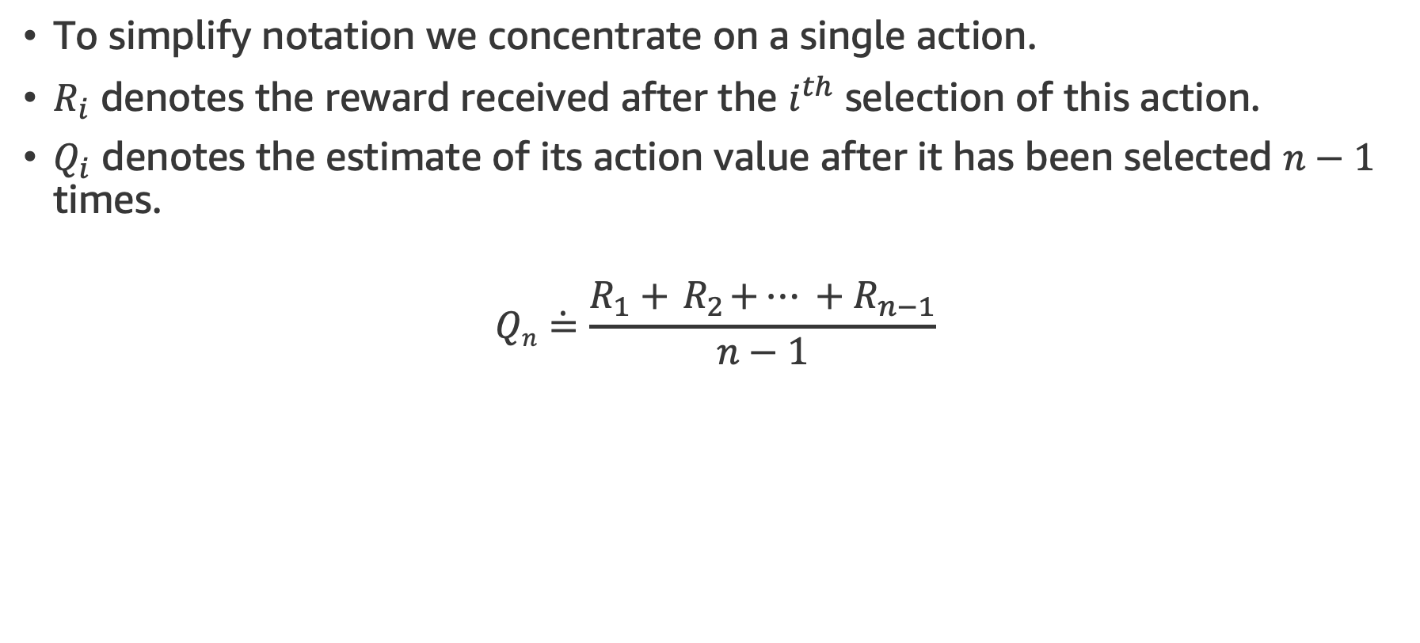
Incremental Implementation
To simplify notation we concentrate on a single action.
$R_{i}$ denotes the reward received after the $i^{th}$ selection of this action.
$Q_{i}$ denotes the estimate of its action value after it has been selected $n−1$ times.
$$Qn\dot{=}\frac{R_{1}+{ R}_{2}+… +R_{n−1}}{n−1}$$

Slide 32
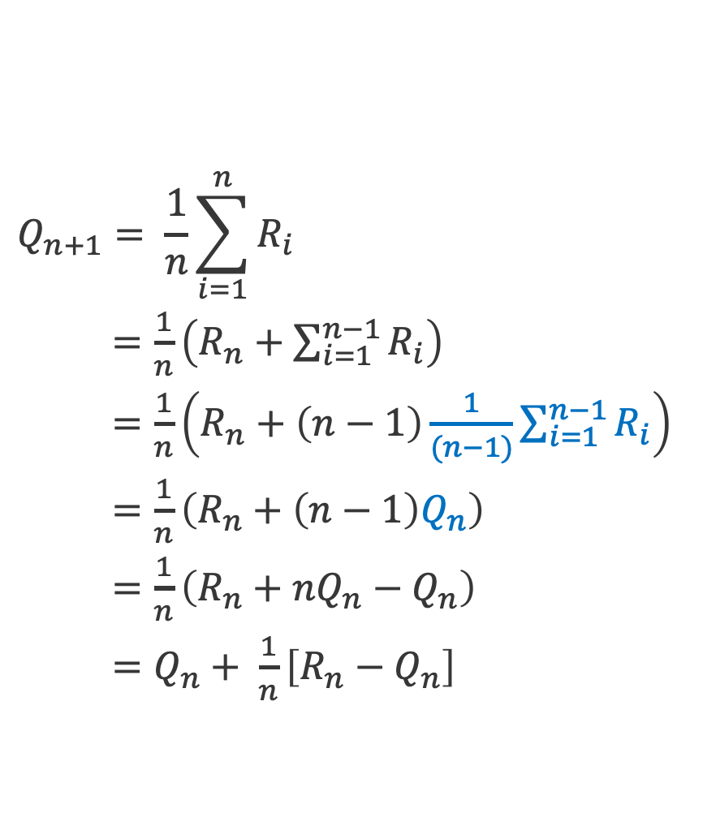
Incremental Implementation
$$Q_{n+1}= \frac{1}{n}\sum_{i=1}^{n}{R_{i}}$$
$=\frac{1}{n}\left(R_{n}+\sum_{i=1}^{n−1}{R_{i}}\right)$
$=\frac{1}{n}\left(R_{n}+\left(n−1\right)\frac{1}{(n−1)}\sum_{i=1}^{n−1}{R_{i}}\right)$
$=\frac{1}{n}\left(R_{n}+\left(n−1\right)Q_{n}\right)$
$=\frac{1}{n}\left(R_{n}+nQ_{n}−Q_{n}\right)$
$=Q_{n}+ \frac{1}{n}\left[R_{n}−Q_{n}\right]$
It is easy to devise incremental formulas for updating averages with small, constant computation required to process each new reward.
This implementation requires memory only for Q_{n} and n, and only the small computation for each new reward.

Slide 33
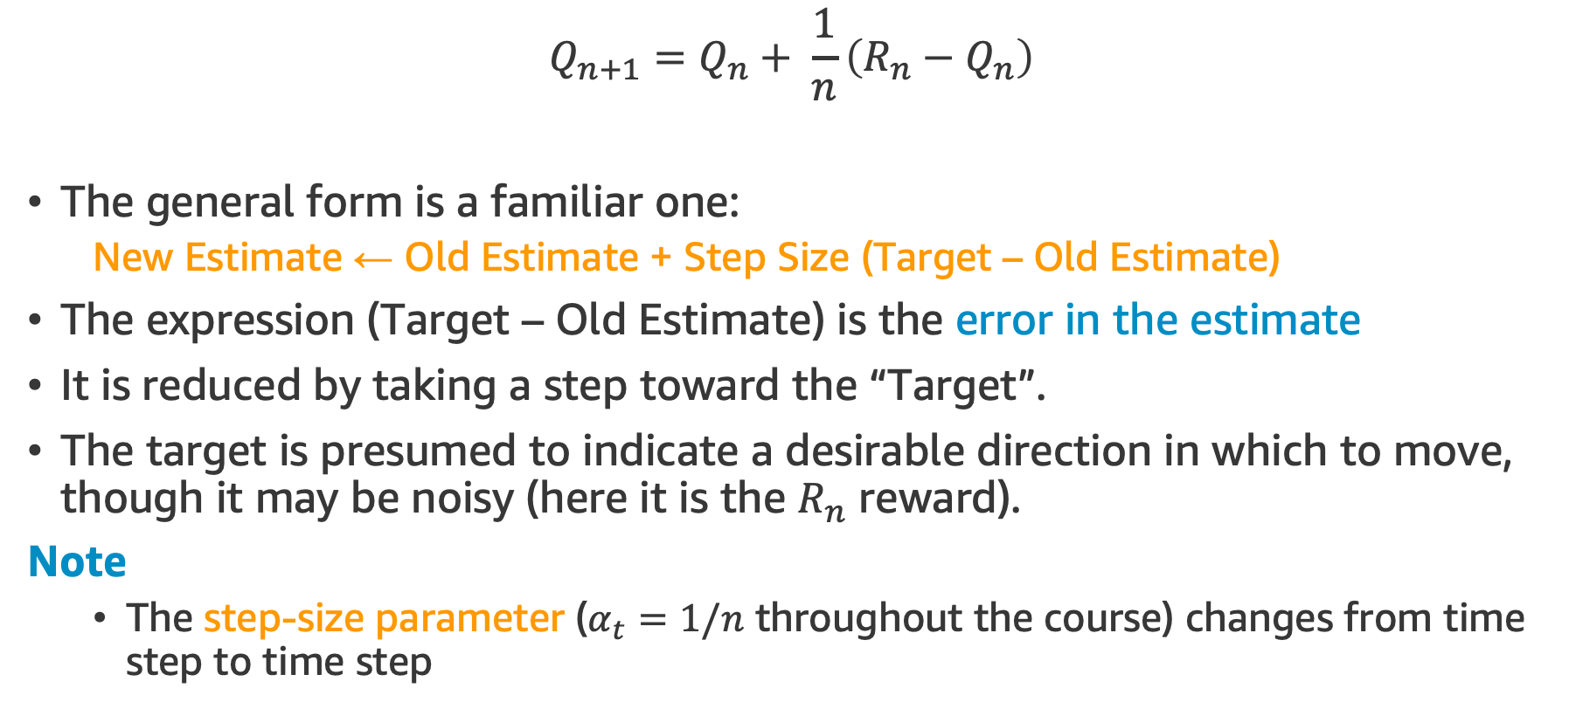
Incremental Implementation
$$Q_{n+1}=Q_{n}+ \frac{1}{n}\left(R_{n}−Q_{n}\right)$$
The general form is a familiar one:
New Estimate ← Old Estimate + Step Size (Target – Old Estimate)
The expression (Target – Old Estimate) is the error in the estimate
It is reduced by taking a step toward the “Target”.
The target is presumed to indicate a desirable direction in which to move, though it may be noisy (here it is the $R_{n}$ reward).
Note
The step-size parameter ($α_{t}=1/n$ throughout the course) changes from time step to time step

Slide 34
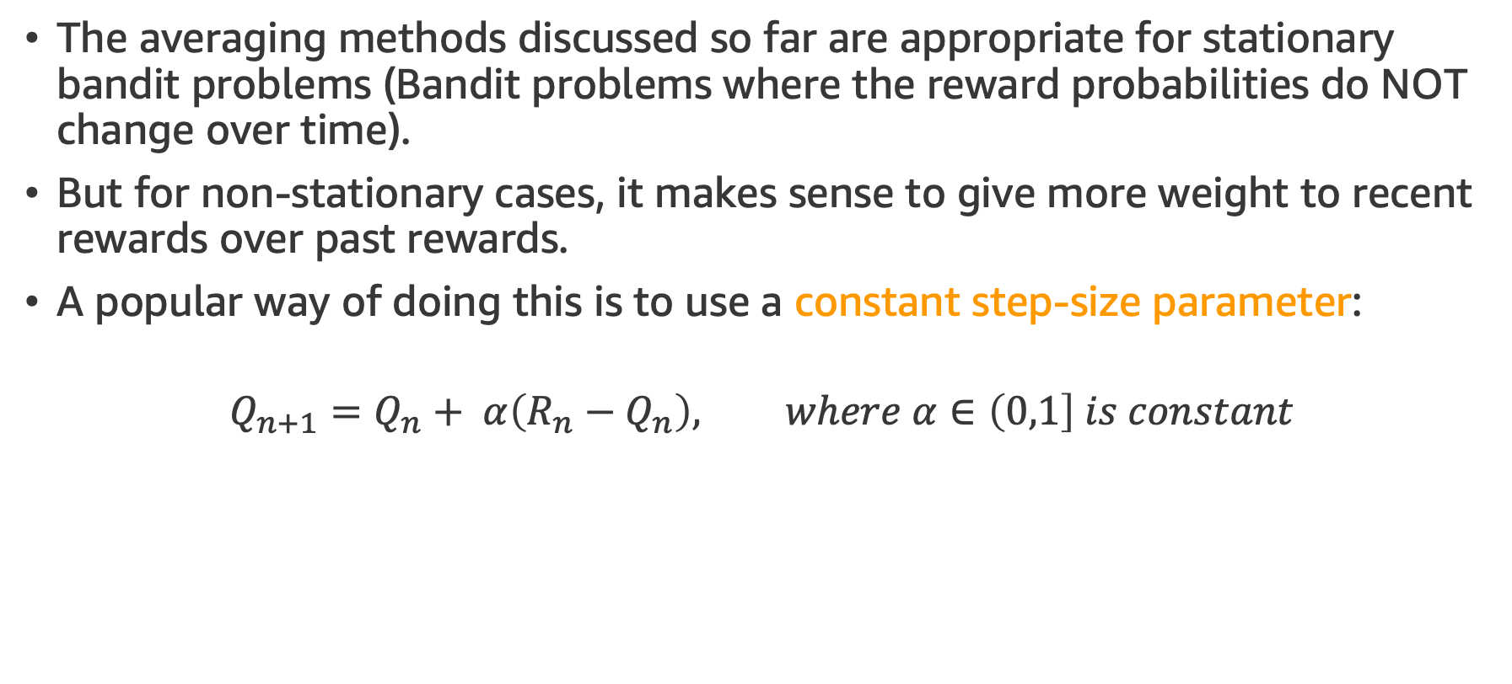
Tracking a Non-stationary Problem
The averaging methods discussed so far are appropriate for stationary bandit problems (Bandit problems where the reward probabilities do NOT change over time).
But for non-stationary cases, it makes sense to give more weight to recent rewards over past rewards.
A popular way of doing this is to use a constant step-size parameter:
$$Q_{n+1}=Q_{n}+ α\left(R_{n}−Q_{n}\right), where α∈\left(0,1\right] is constant$$

Slide 35
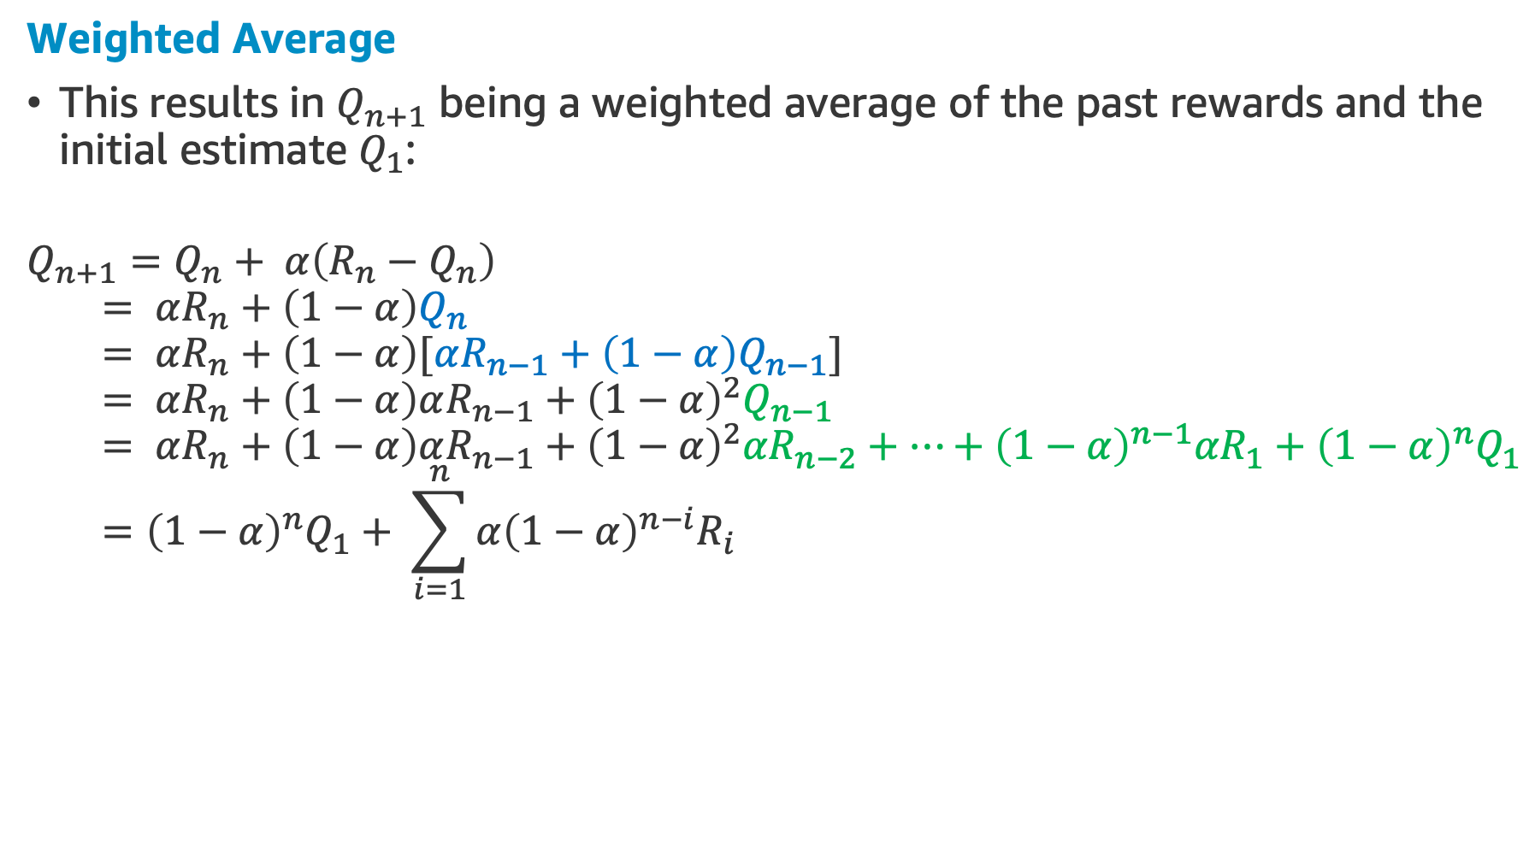
Tracking a Non-stationary Problem
Weighted Average
This results in $Q_{n+1}$ being a weighted average of the past rewards and the initial estimate $Q_{1}$:
$$Q_{n+1}=Q_{n}+ α\left(R_{n}−Q_{n}\right)$$
$$= αR_{n}+\left(1−α\right)Q_{n}$$
$$= αR_{n}+\left(1−α\right)[αR_{n−1}+\left(1−α\right)Q_{n−1}]$$
$$= αR_{n}+\left(1−α\right)αR_{n−1}+{\left(1−α\right)}^{2}Q_{n−1}$$
$$= αR_{n}+\left(1−α\right)αR_{n−1}+{\left(1−α\right)}^{2}{αR}_{n−2}+…+{\left(1−α\right)}^{n−1}{αR}_{1}+{\left(1−α\right)}^{n}Q_{1}$$
$$={\left(1−α\right)}^{n}Q_{1}+ \sum_{i=1}^{n}{α{\left(1−α\right)}^{n−i}R_{i}}$$

Slide 36
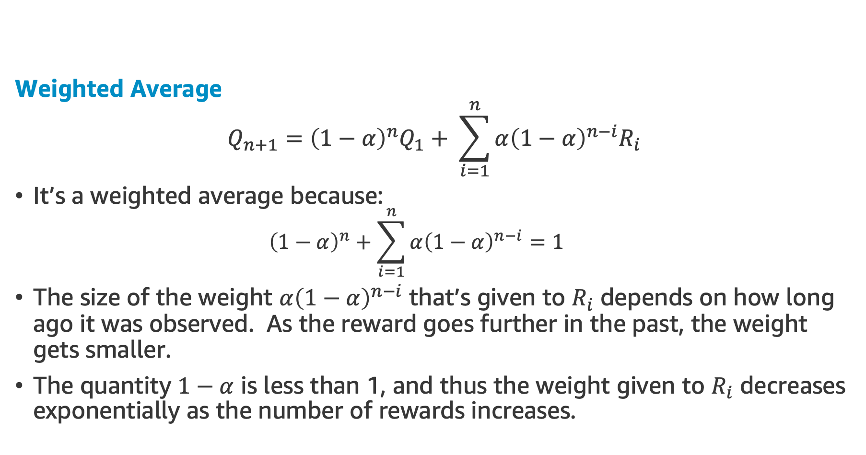
Tracking a Non-stationary Problem
Weighted Average
$$Q_{n+1}={\left(1−α\right)}^{n}Q_{1}+ \sum_{i=1}^{n}{α{\left(1−α\right)}^{n−i}R_{i}}$$
It’s a weighted average because:
$${\left(1−α\right)}^{n}+\sum_{i=1}^{n}{α{\left(1−α\right)}^{n−i}=1}$$
The size of the weight $α{\left(1−α\right)}^{n−i}$ that’s given to $R_{i}$ depends on how long ago it was observed. As the reward goes further in the past, the weight gets smaller.
The quantity $1−α$ is less than 1, and thus the weight given to $R_{i}$ decreases exponentially as the number of rewards increases.
NEXT TOPIC: Improving Bandit Methods

Slide 37
Improving Bandit Methods

Slide 38
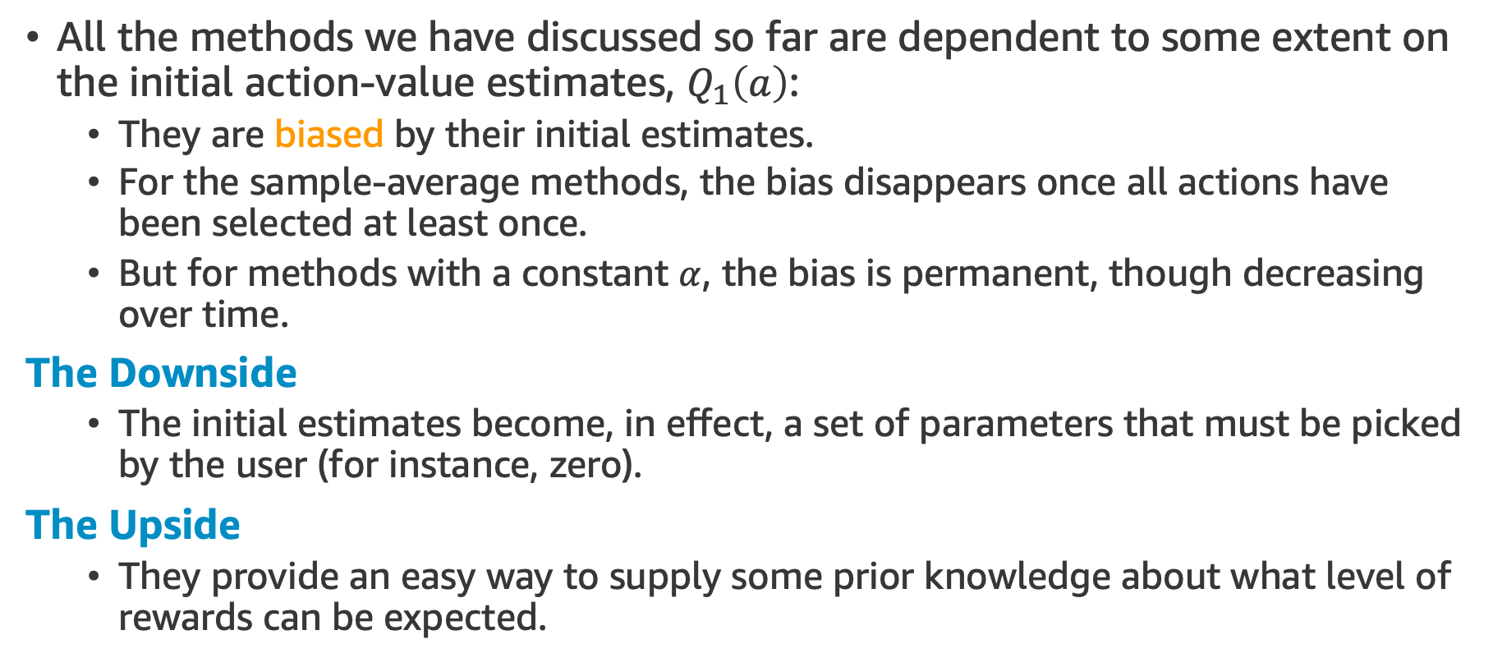
Optimistic Initial Values
All the methods we have discussed so far are dependent to some extent on the initial action-value estimates, $Q_{1}\left(a\right)$:
They are biased by their initial estimates.
For the sample-average methods, the bias disappears once all actions have been selected at least once.
But for methods with a constant $α$, the bias is permanent, though decreasing over time.
The Downside
The initial estimates become, in effect, a set of parameters that must be picked by the user (for instance, zero).
The Upside
They provide an easy way to supply some prior knowledge about what level of rewards can be expected.

Slide 39
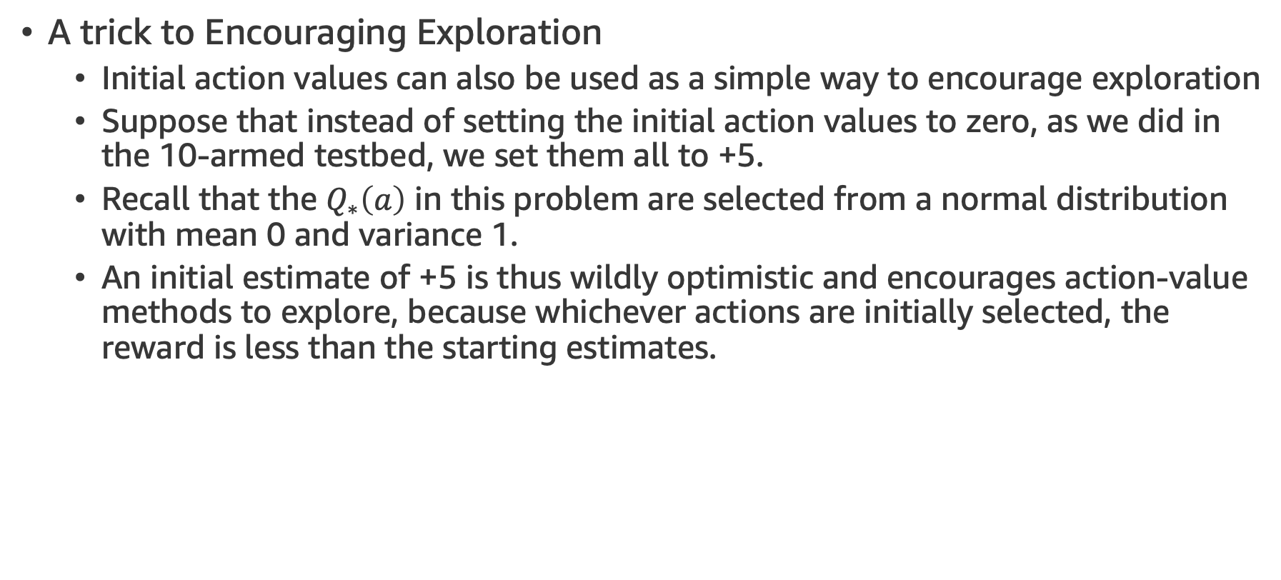
Optimistic Initial Values
A trick to Encouraging Exploration
Initial action values can also be used as a simple way to encourage exploration
Suppose that instead of setting the initial action values to zero, as we did in the 10-armed testbed, we set them all to +5.
Recall that the $Q_{∗}\left(a\right)$ in this problem are selected from a normal distribution with mean 0 and variance 1.
An initial estimate of +5 is thus wildly optimistic and encourages action-value methods to explore, because whichever actions are initially selected, the reward is less than the starting estimates.

Slide 40
Optimistic Initial Values
A trick to Encouraging Exploration
The learner switches to other actions; being “disappointed” with the rewards.
The result is that all actions are tried several times before converging.
This will explore even if greedy actions are selected all the time.
Let’s do some coding! Optimistic Initial Values

Slide 41
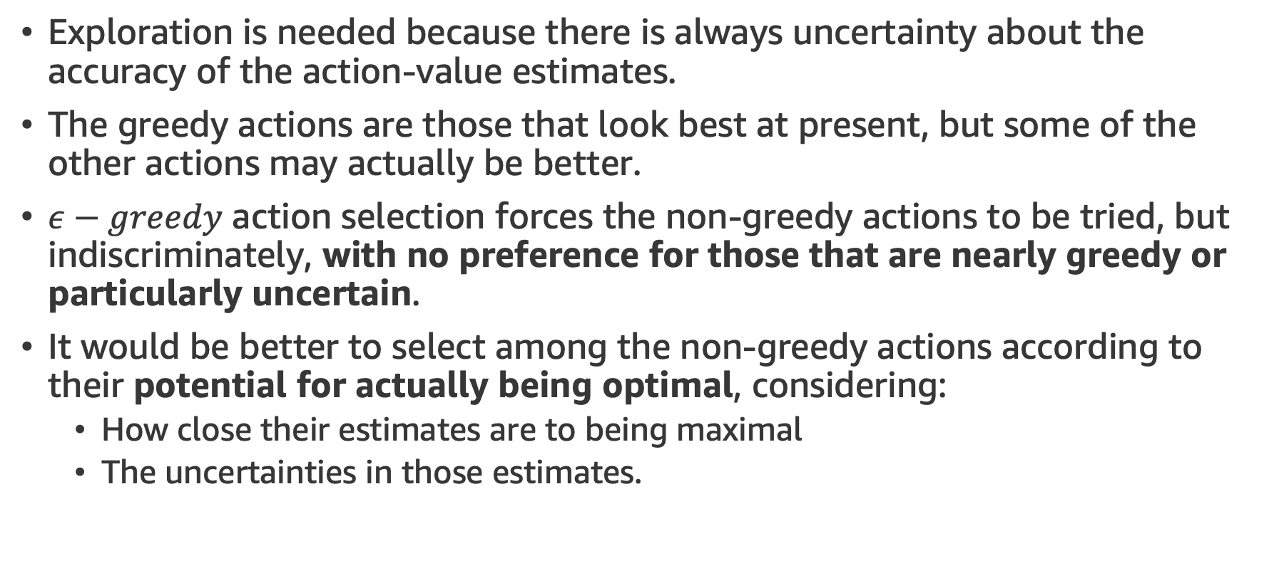
Upper-Confidence-Bound Action Selection
Exploration is needed because there is always uncertainty about the accuracy of the action-value estimates.
The greedy actions are those that look best at present, but some of the other actions may actually be better.
$ε−greedy$ action selection forces the non-greedy actions to be tried, but indiscriminately, with no preference for those that are nearly greedy or particularly uncertain.
It would be better to select among the non-greedy actions according to their potential for actually being optimal, considering:
How close their estimates are to being maximal
The uncertainties in those estimates.

Slide 42
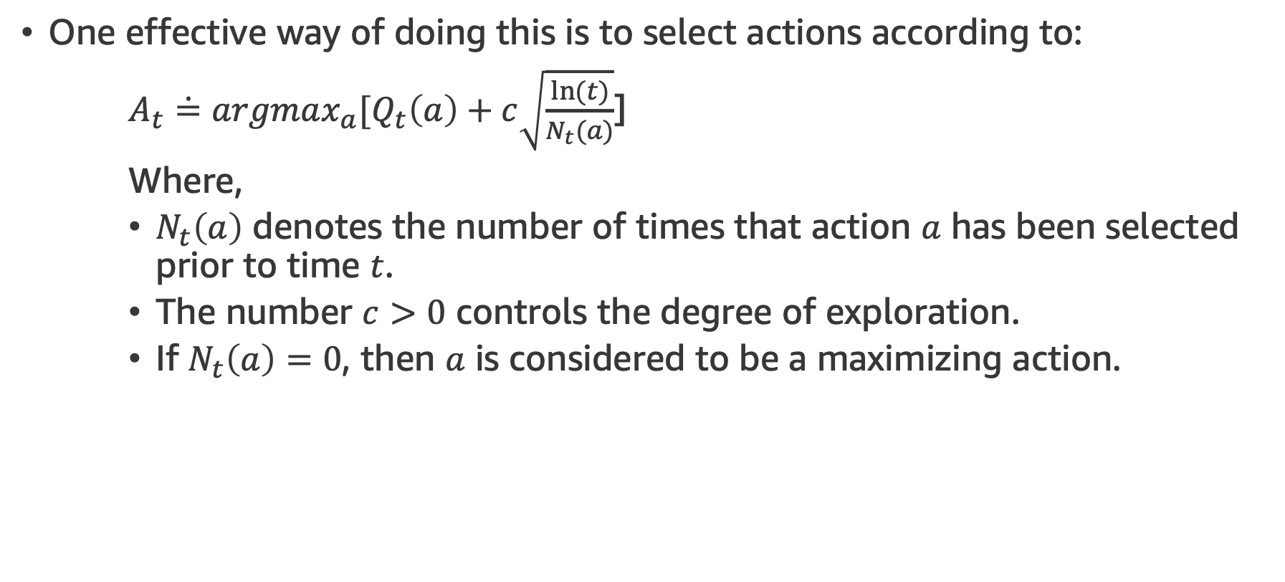
Upper-Confidence-Bound Action Selection
One effective way of doing this is to select actions according to:
$A_{t}\dot{=}argmax_{a}[Q_{t}\left(a\right)+c\sqrt{\frac{ln⁡(t)}{N_{t}(a)}}$]
Where,
$N_{t}\left(a\right)$ denotes the number of times that action $a$ has been selected prior to time $t$.
The number $c>0$ controls the degree of exploration.
If $N_{t}\left(a\right)=0$, then $a$ is considered to be a maximizing action.

Slide 43
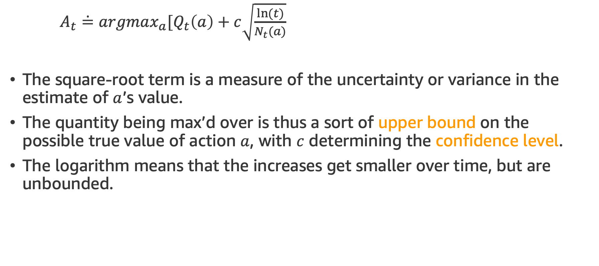
Upper-Confidence-Bound Action Selection
$A_{t}\dot{=}argmax_{a}[Q_{t}\left(a\right)+c\sqrt{\frac{ln⁡(t)}{N_{t}(a)}}$
The square-root term is a measure of the uncertainty or variance in the estimate of $a$’s value.
The quantity being max’d over is thus a sort of upper bound on the possible true value of action $a$, with $c$ determining the confidence level.
The logarithm means that the increases get smaller over time, but are unbounded.

Slide 44
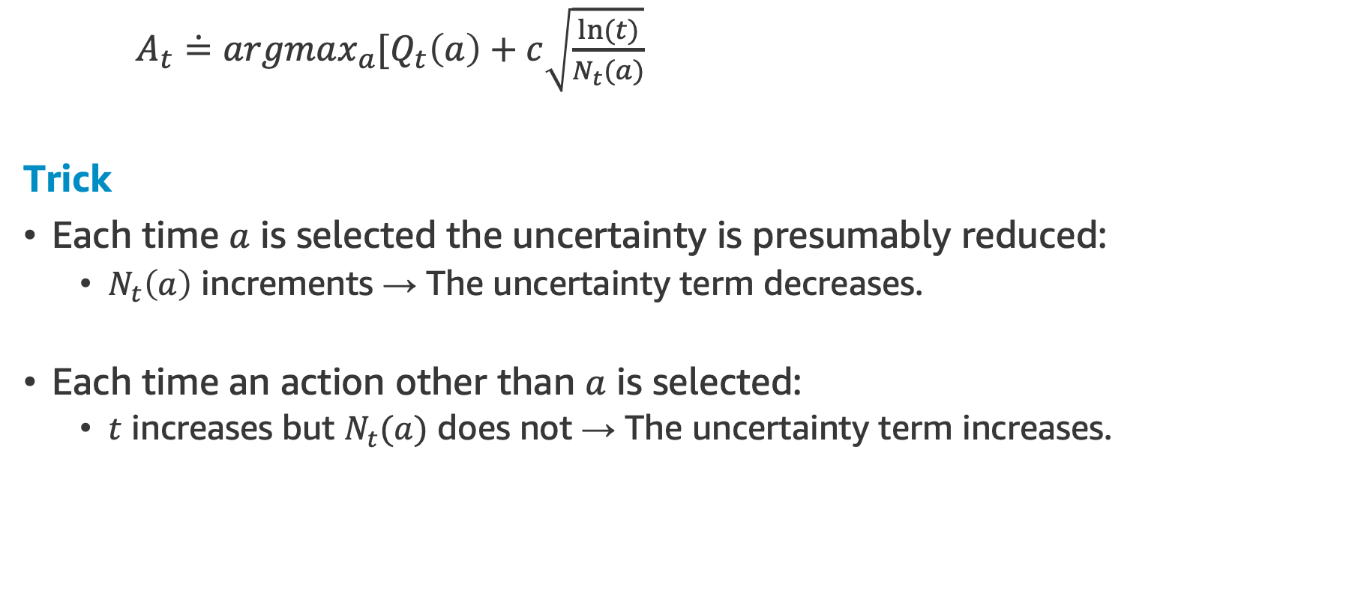
Upper-Confidence-Bound Action Selection
$A_{t}\dot{=}argmax_{a}[Q_{t}\left(a\right)+c\sqrt{\frac{ln⁡(t)}{N_{t}(a)}}$
Trick
Each time $a$ is selected the uncertainty is presumably reduced:
$N_{t}\left(a\right)$ increments → The uncertainty term decreases.
Each time an action other than $a$ is selected:
$t$ increases but $N_{t}(a)$ does not → The uncertainty term increases.

Slide 45
Upper-Confidence-Bound Action Selection
Conclusion
All actions will eventually be selected, but actions with lower value estimates, or that have already been selected frequently, will be selected with decreasing frequency over time.
Let’s do some coding! Upper-Confidence-Bound Action Selection
NEXT TOPIC: Gradient Bandits

Slide 46
Gradient Bandits

Slide 47
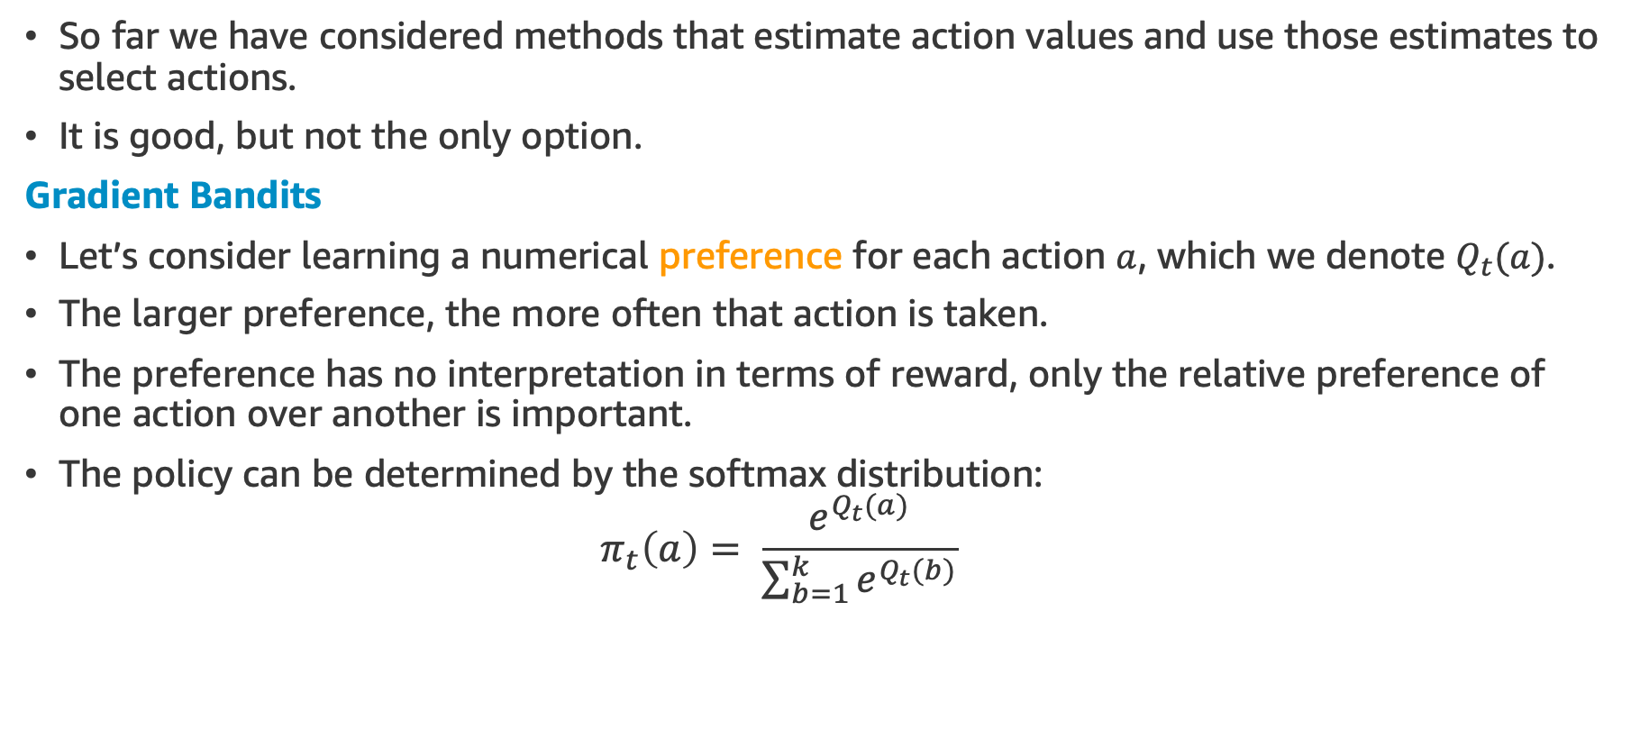
Gradient Bandits
So far we have considered methods that estimate action values and use those estimates to select actions.
It is good, but not the only option.
Gradient Bandits
Let’s consider learning a numerical preference for each action $a$, which we denote $Q_{t}(a)$.
The larger preference, the more often that action is taken.
The preference has no interpretation in terms of reward, only the relative preference of one action over another is important.
The policy can be determined by the softmax distribution:
$$π_{t}\left(a\right)= \frac{e^{Q_{t}(a)}}{\sum_{b=1}^{k}{e^{Q_{t}(b)}}}$$

Slide 48
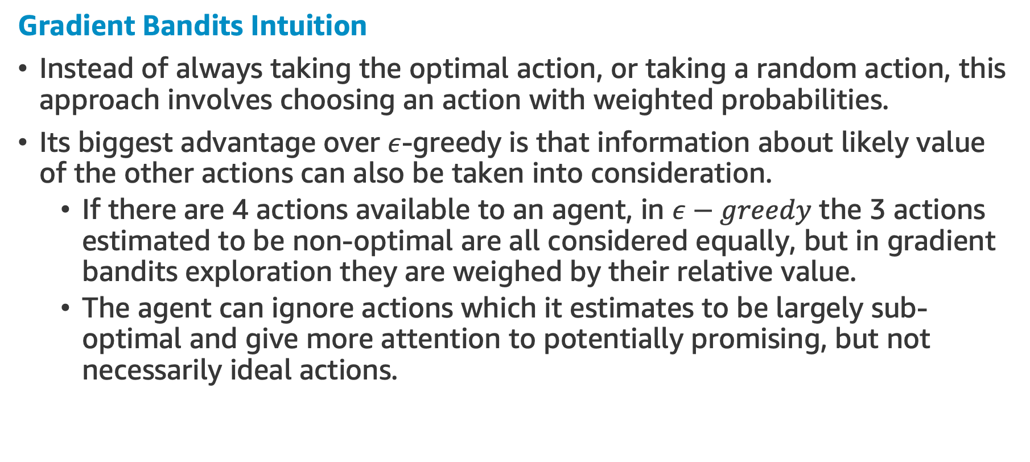
Gradient Bandits
Gradient Bandits Intuition
Instead of always taking the optimal action, or taking a random action, this approach involves choosing an action with weighted probabilities.
Its biggest advantage over $ε$-greedy is that information about likely value of the other actions can also be taken into consideration.
If there are 4 actions available to an agent, in $ε−greedy$ the 3 actions estimated to be non-optimal are all considered equally, but in gradient bandits exploration they are weighed by their relative value.
The agent can ignore actions which it estimates to be largely sub-optimal and give more attention to potentially promising, but not necessarily ideal actions.

Slide 49
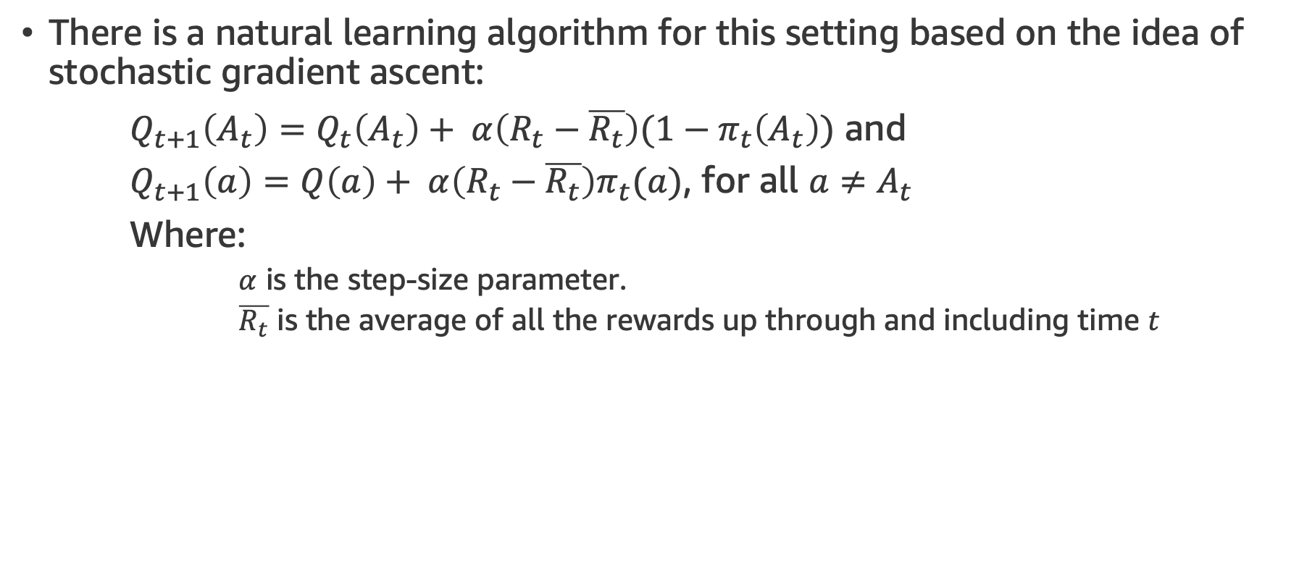
Gradient Bandits
There is a natural learning algorithm for this setting based on the idea of stochastic gradient ascent:
$Q_{t+1}\left(A_{t}\right)=Q_{t}\left(A_{t}\right)+ α\left(R_{t}−\overline{R_{t}}\right)(1−π_{t}\left(A_{t}\right))$ and
$Q_{t+1}\left(a\right)=Q\left(a\right)+ α\left(R_{t}−\overline{R_{t}}\right)π_{t}(a)$, for all $a≠A_{t}$
Where:
$α$ is the step-size parameter.
$\overline{R_{t}}$ is the average of all the rewards up through and including time $t$

Slide 50
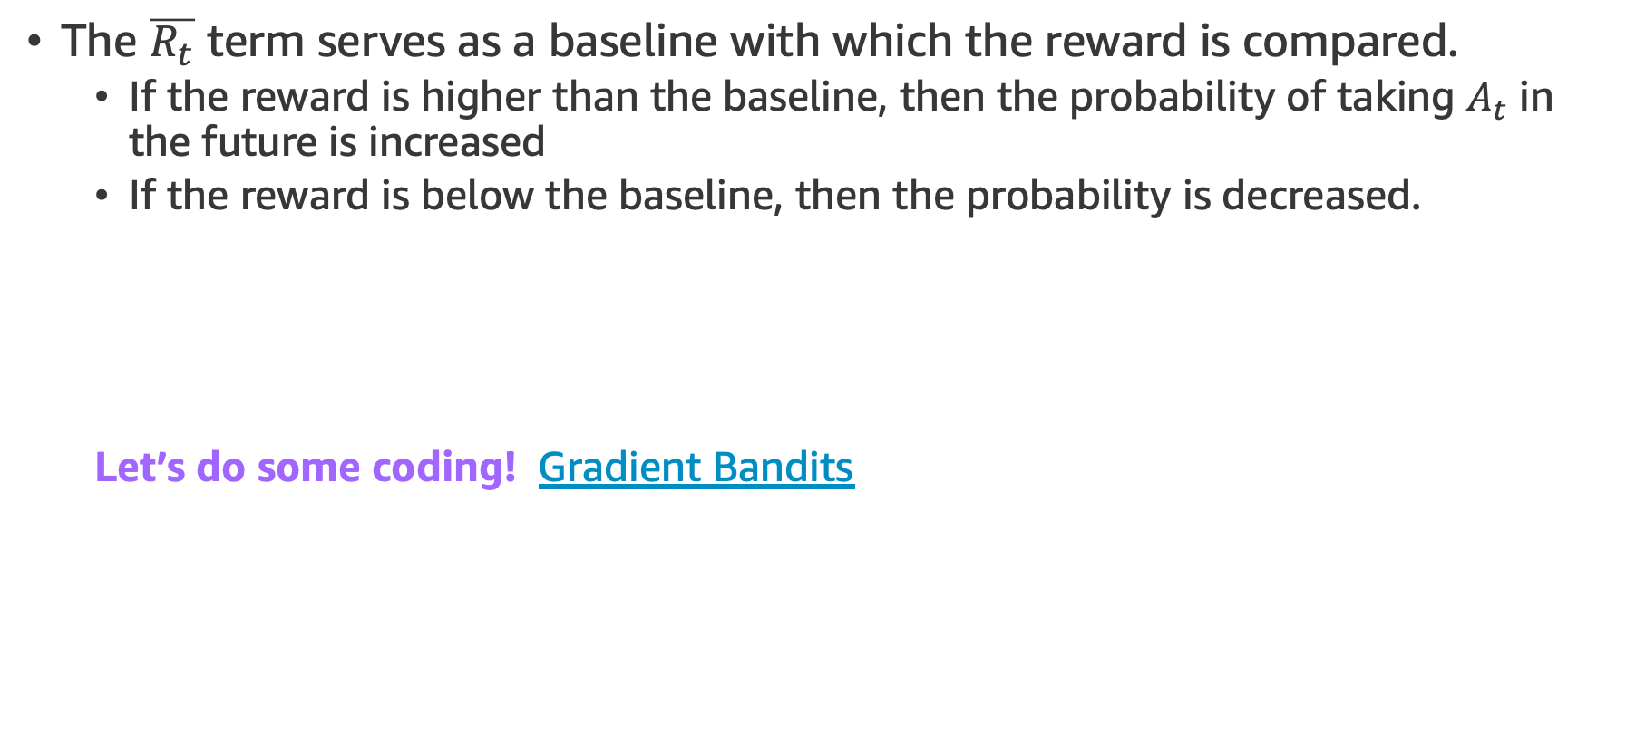
Gradient Bandits
The $\overline{R_{t}}$ term serves as a baseline with which the reward is compared.
If the reward is higher than the baseline, then the probability of taking $A_{t}$ in the future is increased
If the reward is below the baseline, then the probability is decreased.
Let’s do some coding! Gradient Bandits
NEXT TOPIC: Contextual Bandits

Slide 51
Contextual Bandits

Slide 52
Associative Search (Contextual Bandits)
So far we have considered only non-associative tasks, that is, tasks in which there is no need to associate different actions with different situations.
Associative Search Tasks (a.k.a. Contextual Bandits)
It involves both trial-and-error learning to search for the best actions, and association of these actions with the situations in which they are best.
Contextual Bandits are intermediate between the k-armed bandit problem and the full reinforcement learning problem.
They are like the full reinforcement learning problem* in that they involve learning a policy, but like our version of the k-armed bandit problem in that each action effects only the immediate reward.
* If actions are allowed to effect the next situation as well as the reward, then we have the full reinforcement learning problem.

Slide 53
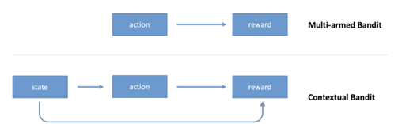
Contextual Bandits
The multi-armed bandit algorithm outputs an action but doesn’t use any information about the state of the environment (context).
For example, if you use a multi-armed bandit to choose whether to display cat images or dog images to the user of your website, you’ll make the same random decision even if you know something about preferences of the user.
The contextual bandit extends the model by making the decision conditional on the state of the environment.

Slide 54
Contextual Bandits
You not only optimize decisions based on previous observations, but you also personalize decisions for every situation.
You will show an image of a cat to a cat person, and an image of a dog to a dog person, you may show different images at different times of the day and days of the week.

Slide 55
Contextual Bandits
Example of Application
You can use a contextual bandit to select which news article to show first on the main page of your website to optimize click through rate.
The context is the information about the user:
Where they come from, previously visited pages, device, geolocation, etc…
An action is a choice of what news article to display.
An outcome is whether the user clicked on a link or not.
A reward is binary: 0 if there is no click, 1 if there is a click.

Slide 56
Contextual Bandits
You can think about reinforcement learning as an extension of contextual bandits.

Slide 57
Parameter Study Graphs
Which of these methods is best?
We could certainly run them all on the 10-armed testbed that we have used throughout this lecture and compare their performances.
But, as they all have a parameter, to get a meaningful comparison we have to consider their performance as a function of their parameter.
Our graphs so far have shown the course of learning over time for each algorithm and parameter setting, to produce a learning curve for that algorithm and parameter setting.

Slide 58
Parameter Study Graphs
Plotting the learning curves for all algorithms and all parameter settings will lead to a plot too complex and crowded to make clear comparisons.
Instead let’s summarize a complete learning curve by its average value over the 1000 steps using our 10-armed testbed.
This value is proportional to the area under the learning curve.
Let’s do some coding! Parameter Study Graph
END OF LECTURE

Slide 59
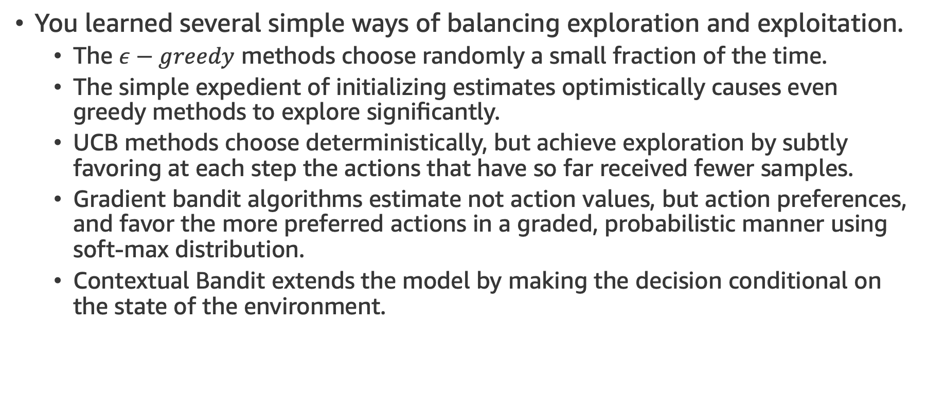
Summary
You learned several simple ways of balancing exploration and exploitation.
The $ε−greedy$ methods choose randomly a small fraction of the time.
The simple expedient of initializing estimates optimistically causes even greedy methods to explore significantly.
UCB methods choose deterministically, but achieve exploration by subtly favoring at each step the actions that have so far received fewer samples.
Gradient bandit algorithms estimate not action values, but action preferences, and favor the more preferred actions in a graded, probabilistic manner using soft-max distribution.
Contextual Bandit extends the model by making the decision conditional on the state of the environment.

Slide 60
References

Slide 61
References

Slide 62
Assignment

Slide 63
Assignment
Welcome to the fifth RL assignment
This week, we'll dive into Multi-Armed Bandits and how they're used to solve problems in experimentation
The main issue is that when you run an experiment you don't want to serve poor performing treatments longer than necessary. Multi-Armed Bandits is a framework solution to this
See detailed explanation of the problem in the assignment notebook RL_assignment_5.ipynb, located in your student’s Sagemaker environment

Slide 64

Demos for This lecture
The DEMO notebook used for this lecture is available in your SageMaker instance, named as RL1_lecture_5_demo.ipynb, into demos folder
You will find each DEMO below in the notebook index
K-Armed Bandit Problem
10-armed Testbed I
10-armed Testbed II
Optimistic Initial Values
Upper-Confidence-Bound Action selection
Graditn bendits
Parameter Study Graph

